Slide 1

AIRBNB Hotel Booking Analysis
Rehaan Ali Mohammed 172663295366ea53f910591

Slide 2

PROBLEM STATEMENT
Analyze New York City Airbnb data to discover key trends in pricing, availability, and customer satisfaction. Using data cleaning, EDA, and visualization, the project aims to generate actionable insights into Airbnb’s market behavior and short-term rental dynamics.

Slide 3
Project Description This project focuses on analyzing Airbnb hotel booking data from New York City to understand the dynamics of short-term rentals. The study involves comprehensive data cleaning, exploratory data analysis (EDA), and visualization to identify trends in pricing, room availability, neighborhood popularity, and customer satisfaction. By applying statistical and analytical techniques, the project aims to provide meaningful insights into Airbnb’s market behavior and assist stakeholders in making data-driven decisions to optimize listing performance and improve customer experience

Slide 4

WHO ARE THE END USERS?
Hosts (Property Owners):
Use insights on pricing, demand, and location trends to optimize their listings and maximize occupancy rates.
Can identify competitive pricing strategies and peak booking seasons.
Guests (Travelers):
Benefit indirectly through improved pricing transparency and better-rated listings.
Can make informed booking decisions based on area popularity and satisfaction scores.
Airbnb Management / Business Analysts:
Gain a data-driven understanding of market dynamics and user preferences.
Can use findings to refine platform algorithms for recommendations and pricing models.
Market Researchers / Data Analysts:
Use the dataset and analytical approach as a case study to learn EDA, visualization, and real-world data storytelling techniques.
City Planners / Tourism Departments:
May use aggregated insights to understand tourism patterns, local demand, and housing impacts

Slide 5

Technology Used
Tech Stack:
Python: Core programming language for analysis and data manipulation.
Pandas: Used for data cleaning, transformation, and handling large datasets efficiently.
NumPy: Performed numerical computations and supported statistical operations.
Matplotlib: Created detailed visualizations and trend plots for data insights.
Seaborn: Enhanced visual aesthetics and pattern detection through advanced graphs.
Jupyter Notebook: Interactive environment for coding, visualization, and documentation.

Slide 6
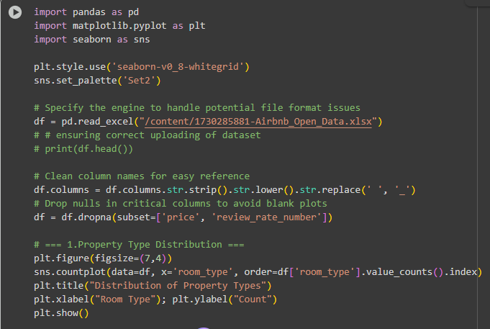
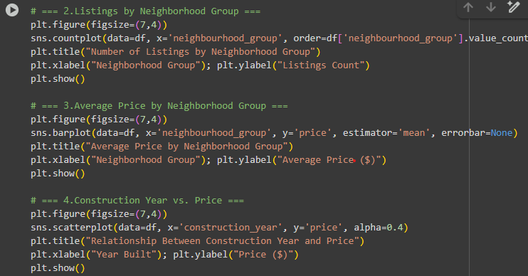
Python Code

Slide 7
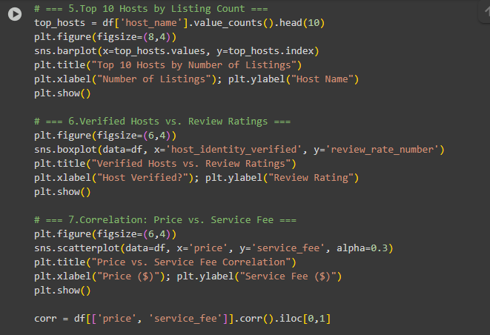
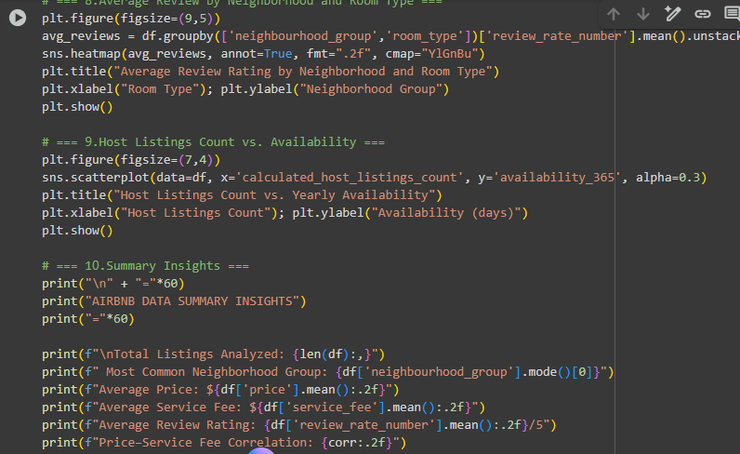
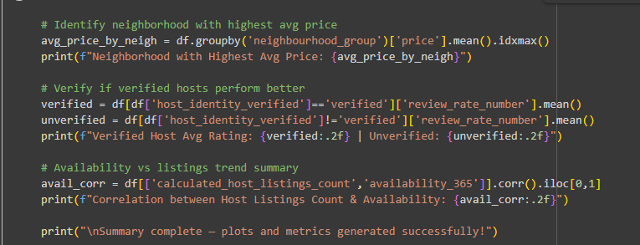

Slide 8
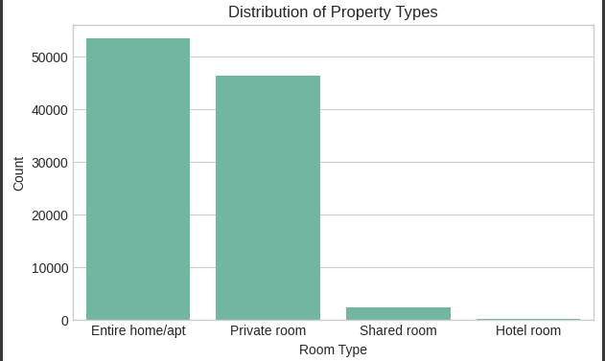
RESULTS1

Slide 9
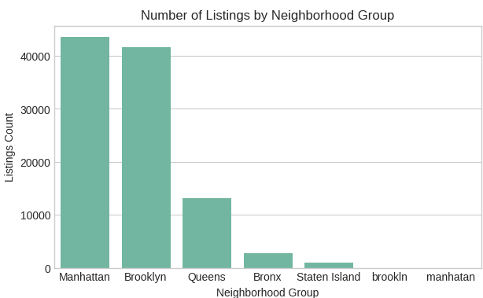
RESULTS2

Slide 10
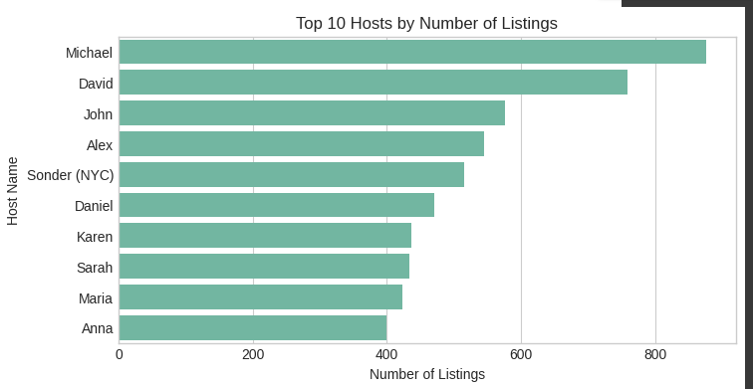
RESULTS3

Slide 11
GitHub repository
https://github.com/Rehaan0745/VOIS_AICTE_Oct2025_Rehaan
Demo Link

Slide 12
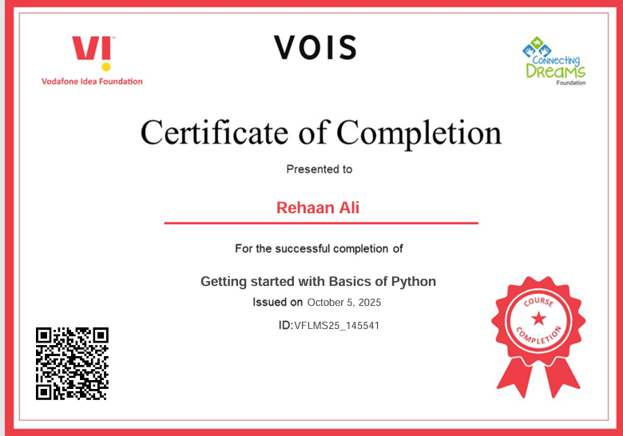
Getting started with Basics of Python Certificate

Slide 13
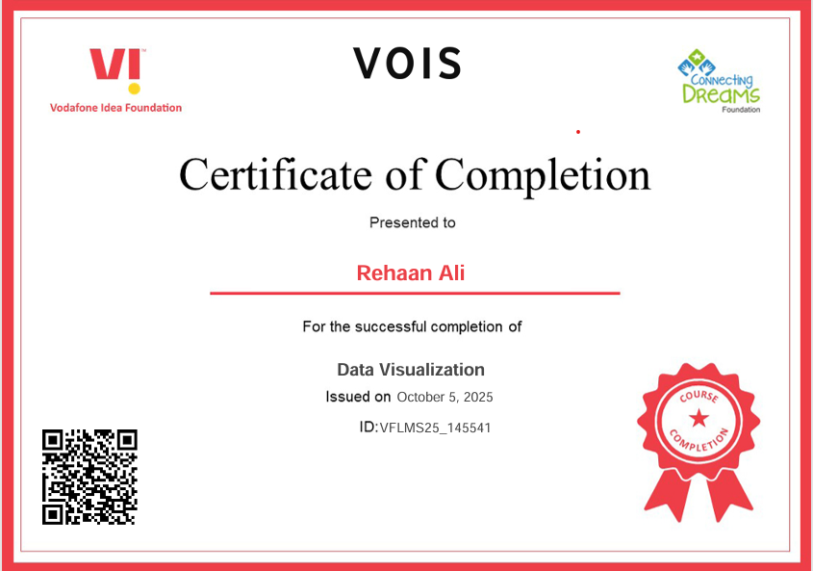
Data Visualization Certificate

Slide 14
Thank you
.
.

